Slide 1
Lean Software Development
Lecturer: Ngo Huy Bien
Software Engineering Department
Faculty of Information Technology
VNUHCM - University of Science
Ho Chi Minh City, Vietnam
nhbien@fit.hcmus.edu.vn

Slide 2

Objectives

Slide 3

Contents

Slide 4

References
Curt Hibbs, Steve Jewett, Mike Sullivan (2009). The Art of Lean Software Development - A Practical and Incremental Approach. O'Reilly Media.
Mary Poppendieck and Tom Poppendieck (2003). Lean Software Development: An Agile Toolkit. Addison Wesley.

Slide 5
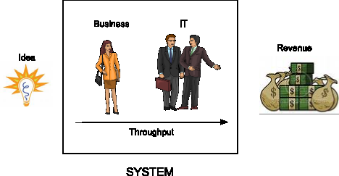
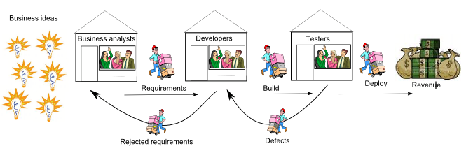
Lean Software Development [1]
Lean is a mindset, a way of thinking about how to deliver value to the customer more quickly by finding and eliminating waste.

Slide 6
Tool 1: Seeing Waste [2]
Partially Done Work
Extra Processes
Extra Features
Task Switching
Waiting
Motion
Defects

Slide 7
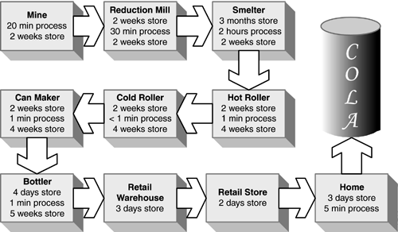
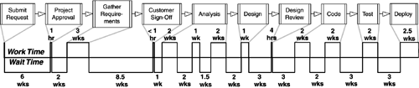
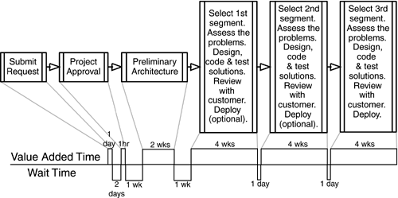
Tool 2: Value Stream Mapping
319 days/3hours

Slide 8
Amplify Learning
Variability: dynamically shifting customer expectations require variation, while in manufacturing, variation is the enemy.
Design Cycles: short, repeated cycles of investigation, experimentation, and checking the results.
Do It Right the First Time? The right the first time approach may work for well-structured problems, but the try-it, test-it, fix-it approach is usually the better approach for ill-structured problems.
Learning Cycles: working software tends to generate better knowledge faster

Slide 9

Tool 3: Feedback
Instead of letting defects accumulate,
run tests as soon as the code is written.
Instead of adding more documentation
or detailed planning, try checking out ideas by writing code.
Instead of gathering more requirements from users, show them an assortment of potential user screens and get their input.
Instead of studying more carefully which tool to use, bring the top three candidates inhouse and test them.
Instead of trying to figure out how to convert an entire system in a single massive effort, create a Web front end to the legacy system and try the new idea out.

Slide 10
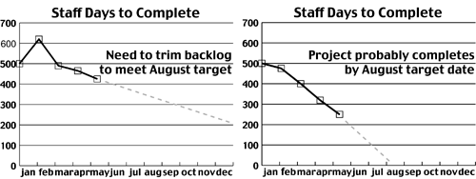
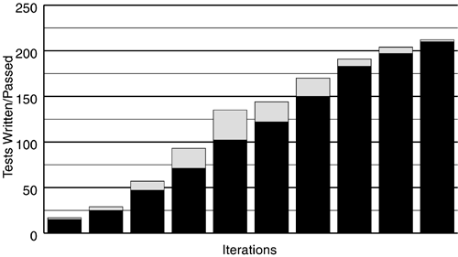
Tool 4: Iterations
Iteration Planning
Convergence
Negotiable Scope
Team Commitment

Slide 11

Thank You & See You Again

